Slide 1
University of Miami Capstone Credit score development April 2022

Slide 2
Agenda
Introductions
Project objectives
Overview of consumer credit
Regulatory constraints
Data
Resources
Follow-up items
Wrap up
Notes:
As you can see here on the agenda, I’ll talk about the features of Experian’s Credit Profile Report, share the different formats our clients can receive the report. Discuss the different credit bands of information on the report and tell you about some additional options a client can include on their report.

Slide 3
Introductions
Introduction of Experian and University of Miami team members
Brief overview of Experian
Consumer credit bureau
Business credit bureau
Consumer services
Analytics
Software

Slide 4

Objectives
To develop a solution to determine the likelihood of consumers to go severely delinquent over a 24-month period according to the following:
Assess machine learning techniques
Evaluate variable reduction techniques for highly dimensional data
Other innovative approaches or perspectives
Complies with federal regulations
Assess results against Experian commercial scores developed using logistic regression and boosted decision trees

Slide 5
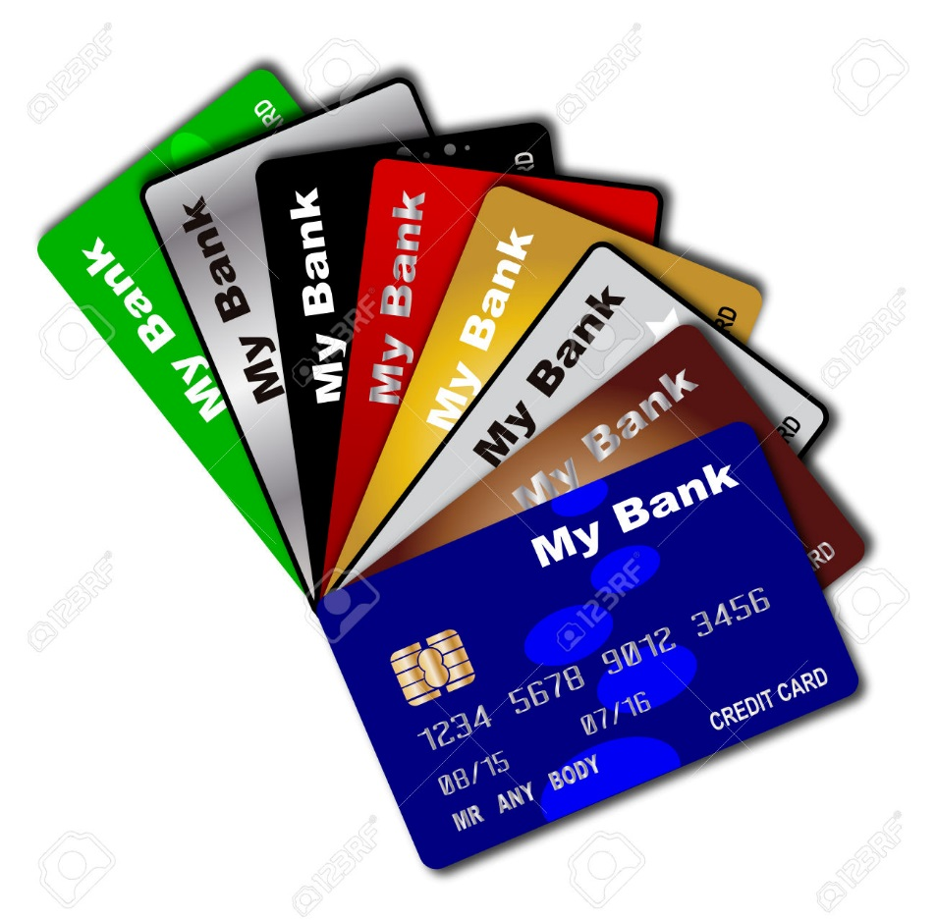
Consumer credit usage
Permissible purposes
Consumer initiated request to apply for credit products such as:
Auto loans
Bankcards
Mortgages
Services or contracts
Rental, lease contracts
Employment screening
Auto insurance
Financial institution initiated
Account review
Collection of bad or delinquent debt
Marketing
Solicitation of consumers for firm offers of credit

Slide 6

Actions based on credit data
Approve, decline decision for credit applications
Pricing
Interest rates based on risk
Insurance rates
Down payment requirements
Credit limit management
Increase
Decrease
Collection prioritizations
Send firm offer of credit

Slide 7
Materials, information provided
Data set
Comma delimited file
5,706,866 consumers
1,975,199 ‘Bad’
3,731,667 ‘Good’
Population
13,500,455 ‘Bad’
181,253,162 ‘Good’
Random stratified sample
Variables
299 independent
3 scores
13 case weights
14 dependent
Documentation
Data dictionary

Slide 8

Observation point and outcome period Decision and consequence
There is no overlap in the observation point and the performance window
A lender will assess a consumer’s likelihood to go severely delinquent
Based on the likelihood of going severely delinquent the lender will make decide:
Approve/decline credit application
Increase/decrease credit limit
Price the loan (interest rate)

Slide 9
Sample design Sample time frame
Public record BK overlay
20170628
20190630
Existing
New
24-months
20170701
24-months
20170731
20190729
1-month

Slide 10

Data design Performance tag
Consumers are tagged when a consumer goes severely delinquent in the performance window
Tag
1 – Consumer went no worse than 60 DPD
0 – Consumer went 90+ DPD or worse
60 DPD = 3 missed payment
90+ DPD = 4 or more missed payments, filed bankruptcy, or contractual charge-off

Slide 11

Independent variables Summarized credit data from observation period
Calculated as of the observation point/date
Analysis variables for project: 299
Approximately 6000 independent variables in original dataset
Significant analytical challenge to reduce dimensionality

Slide 12

Independent variables
Variables divided into two parts
Range of valid values
0-90
0-990
0-9990
0-999999990
Default value
91-99
991-999
9991-9999
999999991-999999999

Slide 13

Default values
Last byte of variable in default range
‘9’ no valid accounts of any type
‘8’ no account of industry subtype
‘7’ no accounts reported within time frame
‘6’ no open accounts of type/subtype
‘5’ no valid credit limit
‘4’ other missing information

Slide 14
Characteristic analysis report TTL TRD EVER 30+ INCL UNSAT NON-MED IN 12M
 | ALM2317 | GOOD COUNT (A) _____ | GOOD PERCENT (B) ______ | BAD COUNT (C) _____ | BAD PERCENT (D) ______ | CELL FREQ (E) ____ | KNOWN G/B ODDS (F) _____ | KNOWN G/B INDEX (G) _____ | <<<<<----------- RATIO ----------->>>>> | WGT OF EVIDENCE (H) ________ | INFO INCREMENT (I) ________
A | -3 | 62,041 | 0.28 | 5,963 | 0.38 | 0.29 | 10.40 | 136B | < -1.36 > | -0.31 | 0.03
B | -1 | 11,327 | 0.05 | 3,767 | 0.24 | 0.06 | 3.01 | 472B | < -4.72 > | -1.55 | 0.30
C | 0 | 18,058,248 | 81.87 | 648,154 | 41.68 | 79.22 | 27.86 | 196G | < 1.96 > | 0.68 | 27.13
D | 1 | 2,260,926 | 10.25 | 342,055 | 22.00 | 11.02 | 6.61 | 215B | < -2.15 > | -0.76 | 8.97
E | 2 | 781,436 | 3.54 | 203,390 | 13.08 | 4.17 | 3.84 | 369B | < -3.69 > | -1.31 | 12.46
F | 3 | 362,963 | 1.65 | 119,876 | 7.71 | 2.04 | 3.03 | 468B | < -4.68 > | -1.54 | 9.36
G | 4 TO 6 | 369,424 | 1.67 | 155,958 | 10.03 | 2.23 | 2.37 | 599B | < -5.99 > | -1.79 | 14.95
H | 7 TO 41 | 150,875 | 0.68 | 75,912 | 4.88 | 0.96 | 1.99 | 714B | < -7.14 > | -1.97 | 8.25
 |  | 22,057,241 | 100.00 | 1,555,075 | 100.00 | 100.00 |  |  |  |  | 81.45

Slide 15
Performance benchmarks
Lift Plus commercial scores
Lift Plus logistic
Segment solution
Suite of 12 models
180 independent variables
Lift Plus ML
XGBoost
197 independent variables
Simple single model logistic

Slide 16
Constraints
Financial institutions must make available the logical primary reasons where any adverse action occurred
Denied credit
Receipt of less than best interest rate
Credit limit decrease
Requested credit limit increased denied
Up to 5 reasons
Must pass logical validity test
Monotonic interpretation of a given independent variable
Common sense interpretation
Can be understood by consumer
Prevent variable reduction through factor analysis
Cannot discriminate against protected classes

Slide 17
Performance report example
 |  |  |  | TOTAL NUMBER OF |  |  |  |  | CUMULATIVE |  |  |  |  | CUM DIFF | BAD RATE
INT | RANGE | RANGE | RANGE | TOTAL | GOOD | IND | BAD | LOSS | TOTAL | GOOD | IND | TOT | LOSS | GOOD | INTER | CUMU | DECUMU
 | LOW | HIGH | MEAN | (D) | (E) | (F) | (G) | (H) | (I) | (J) | (K) | BAD | (M) | BAD(N) | VAL | LATIVE | LATIVE
 | (A) | (B) | (C) |  |  |  |  |  |  |  |  | (L) |  |  | (O) | (P) | (Q)
1 | 825 | 850 | 834.15 | 106,450 | 106,398 | 0 | 52 | 0 | 5% | 5% | . | 0% | 0% | 5% | 0.05% | 0.05% | 4.58%
2 | 812 | 824 | 817.64 | 107,961 | 107,852 | 0 | 109 | 0 | 10% | 11% | . | 0% | 0% | 11% | 0.10% | 0.08% | 4.82%
3 | 802 | 811 | 806.41 | 101,038 | 100,917 | 0 | 121 | 0 | 15% | 16% | . | 0% | 0% | 16% | 0.12% | 0.09% | 5.10%
4 | 792 | 801 | 796.5 | 104,445 | 104,218 | 0 | 227 | 0 | 20% | 21% | . | 1% | 0% | 21% | 0.22% | 0.12% | 5.38%
5 | 782 | 791 | 786.53 | 106,454 | 106,132 | 0 | 322 | 0 | 25% | 27% | . | 1% | 0% | 26% | 0.30% | 0.16% | 5.71%
6 | 770 | 781 | 776.17 | 99,860 | 99,452 | 0 | 408 | 0 | 30% | 32% | . | 1% | 0% | 30% | 0.41% | 0.20% | 6.08%
7 | 755 | 769 | 762.03 | 100,577 | 100,054 | 0 | 523 | 0 | 35% | 37% | . | 2% | 0% | 35% | 0.52% | 0.24% | 6.47%
8 | 739 | 754 | 746.45 | 109,180 | 108,334 | 0 | 846 | 0 | 40% | 42% | . | 3% | 0% | 39% | 0.78% | 0.31% | 6.92%
9 | 725 | 738 | 731.4 | 100,987 | 99,982 | 0 | 1,005 | 0 | 45% | 47% | . | 4% | 0% | 43% | 1.00% | 0.39% | 7.46%
10 | 711 | 724 | 717.51 | 104,953 | 103,489 | 0 | 1,464 | 0 | 50% | 52% | . | 5% | 0% | 47% | 1.39% | 0.49% | 8.03%
11 | 697 | 710 | 703.6 | 99,101 | 97,265 | 0 | 1,836 | 0 | 55% | 57% | . | 7% | 0% | 50% | 1.85% | 0.61% | 8.71%
12 | 679 | 696 | 687.73 | 107,697 | 105,041 | 0 | 2,656 | 0 | 60% | 63% | . | 10% | 0% | 53% | 2.47% | 0.77% | 9.44%
13 | 661 | 678 | 669.4 | 100,502 | 97,611 | 0 | 2,891 | 0 | 65% | 68% | . | 13% | 0% | 54% | 2.88% | 0.92% | 10.40%
14 | 644 | 660 | 652.02 | 103,099 | 99,378 | 0 | 3,721 | 0 | 70% | 73% | . | 17% | 0% | 56% | 3.61% | 1.11% | 11.40%
15 | 630 | 643 | 636.32 | 103,098 | 98,207 | 0 | 4,891 | 0 | 75% | 78% | . | 22% | 0% | 55% | 4.74% | 1.35% | 12.70%
16 | 615 | 629 | 622.13 | 106,856 | 100,375 | 0 | 6,481 | 0 | 80% | 83% | . | 29% | 0% | 54% | 6.07% | 1.66% | 14.30%
17 | 598 | 614 | 606.33 | 101,384 | 93,280 | 0 | 8,104 | 0 | 85% | 87% | . | 38% | 0% | 50% | 7.99% | 2.02% | 16.40%
18 | 571 | 597 | 584.35 | 101,650 | 89,992 | 0 | 11,658 | 0 | 90% | 92% | . | 50% | 0% | 42% | 11.50% | 2.54% | 19.20%
19 | 535 | 570 | 553.7 | 105,085 | 86,668 | 0 | 18,417 | 0 | 95% | 96% | . | 69% | 0% | 27% | 17.50% | 3.34% | 23.00%
20 | 300 | 534 | 499.82 | 101,978 | 72,870 | 0 | 29,108 | 0 | 100% | 100% | . | 100% | 0% | 0% | 28.50% | 4.58% | 28.50%
 |  |  |  | 2,072,356 | 1,977,516 | 0 | 94,840 | 0
GOOD/BAD KS FOR NICHE MODEL= 55.67 AT Lift_PLUS: 635
MIN G/B KS REQUIRED DIFFERENCE AT SIGNIFICANT LEVEL .05: 0.51
GOOD/BAD GINI FOR NICHE MODEL= 71.49
OVERALL BAD RATE: 4.58% OVERALL NB:B ODDS RATIO: 20.9
TOTAL UNWEIGHTED GOOD: 286,109 BAD: 94,840 LOSS: 0
PERCENT BAD IN BOTTOM 10 PERCENT NICHE: 50.11% 20 PERCENT NICHE: 70.95%

Slide 18
Credit Profile Report Formats
TTY
Human Readable
ARF
Automated Response Format
Parallel
Format
Manually read the credit report
Manual decision
Small businesses
Auto dealers, small finance companies
Formatted data
Fed to a client’s system
Produces automated decision
Major banks and lenders
TTY and ARF
Client receives an automated decision into their system and also allows them to perform a manual review
One inquiry is logged to the consumer’s report
Notes:
Our clients can receive the Credit Profile Report in a couple of formats, including
TTY (Teletype) – Which is the human readable format. This allows our clients to manually read the credit report and make a manual decisions. Clients who use this format tend to be smaller businesses, auto dealers, furniture companies, etc.
ARF (Automated Response Format) – This is geared more for our larger clients, such as banks and larger lenders that require formatted data fed into their decision engine to produce an automated decision.
Clients can also receive a Parallel Format of the Credit Report, which is both TTY and ARF. Maybe because they need an automated decision, but they also want to perform a manual review of the report. This format still only logs one inquiry onto the consumer’s credit report.

Slide 19
Credit Bands (TIP) FCRA compliance – below the line
Ident Band
Name, address, SSN, DOB, name variations, employment information
Public Records Band
Bankruptcies, judgments and tax liens
Trade Band
Consists of information on consumer’s relationship with creditors
Inquiry Band
Creditors who have requested a consumer’s report within last 2 years

Slide 20
Credit Profile Report Inquiry Input Consumer Identifying Information
TCA1 RTS 3122250X1J CONSUMER,JONATHAN QUINCY 999999990; CONSUMER,NANCY CHRISTINE 123456789;CA-10655 NORTH BIRCH STREET/BURBANK CA 91502, PH-714.555.1111, DL: CA N2345678, PA-1314 SOPHIA LANE APT #3/SANTA ANA CA 92708-5678, Y-1951, T-04048060, E-AJAX HARDWARE/2035 BROADWAY SUITE 300/LOSANGELES CA 90019
A
B
C
TCA1 RTS 3122250X1J CONSUMER,JONATHAN QUINCY 999999990;
CONSUMER, NANCY CHRISTINE 123456789;
CA-10655 NORTH BIRCH STREET/BURBANK CA 91502, PH-714.555.1111, DL: CA N2345678
PA-1314 SOPHIA LANE APT #3/SANTA ANA CA 92708-5678, Y-1951, T-04048060
E-AJAX HARDWARE/2035 BROADWAY SUITE 300/LOS ANGELES CA 90019
D
F
G
E
I
J
H
K
A
Subscriber Number and Password
C
Social Security Number (SSN)
B
Consumer’s Name
E
Current Address
F
D
Spouse’s name & SSN
Telephone Number
H
Previous Address
Year of Birth
G
Driver License Number
I
Type, Terms & Amount
K
J
Employment

Slide 21
Credit Profile Report Public Records Band
Reporting Court Subscriber
Type of Public Record
--------------------------------------------------------PUBLIC RECORDS--------------------------------------------------------------
* SO CALIF DISTRICT COURT 6-21-13 7-01-14 3011111 $12,450 CO LIEN REL
C#: 45078321 1 BP: B476P2109
* COUNTY SPR CT SANTA ANA 9-19-13 3019999 $1,200 CIV CL JUDG
D#: 7505853 1 PLAINTIFF: ALLIED COMPANY
BP: B1234P50987
* U S BANKRUPTCY COURT 6-12-10 1-11-11 3009999 $129,803-L BK 13-PETIT
D#: 35054539906234561 2 $85,500-A VOLUN
Court Name
Original filing date
Release date
Amount Public Record
Status Date
Record Status
Satisfied
Released
Vacated
Discharged
Dismissed

Slide 22
Credit Profile Report Public Records Band
Consumer’s Association
1 – Individual
2 - Joint
Book & Page Number from Court
---------------------------------------------------------PUBLIC RECORDS---------------------------------------------------
* SO CALIF DISTRICT COURT 6-21-13 7-01-14 3011111 $12,450 CO LIEN REL
C#: 45078321 1 BP: B476P2109
* COUNTY SPR CT SANTA ANA 9-19-13 3019999 $1,200 CIV CL JUDG
D#: 7505853 1 PLAINTIFF: ALLIED COMPANY
BP: B1234P50987
* U S BANKRUPTCY COURT 6-12-10 1-11-11 3009999 $129,803-L BK 13-PETIT
D#: 35054539906234561 2 $85,500-A VOLUN
Plaintiff's name
Certificate or Docket Number
Bankruptcy Amount
L: Liability Amount
A: Asset Amount

Slide 23
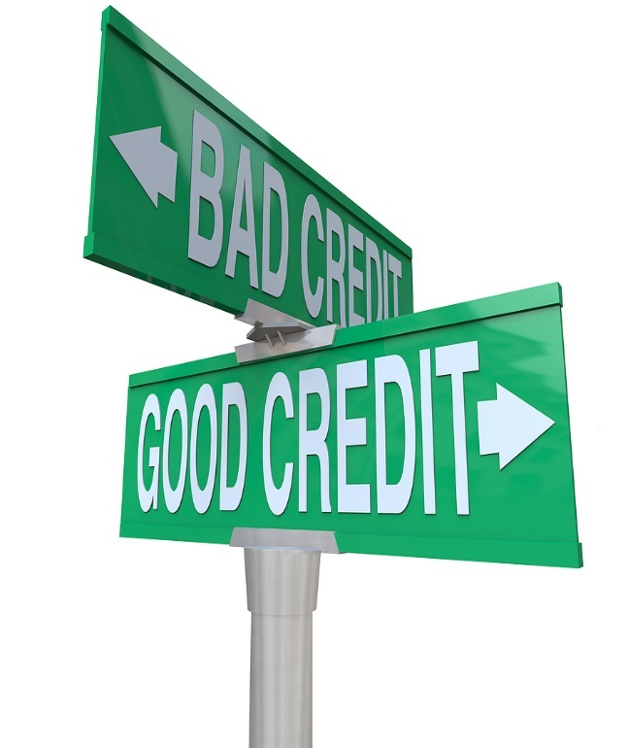
Credit Profile Report Risk Scores
Score name
Score
Score factors and descriptions
------------------------------- SCORE SUMMARY -------------------------------- VANTAGESCORE = 613 SCORE FACTORS: RT OPEN REVOLVING ACCOUNT BALANCE/CREDIT AMOUNT RATIO IS TOO HIGH BP AVAILABLE CREDIT ON OPEN BANKCARD ACCOUNTS IS TOO LOW TV NEWEST DELINQUENCY/DEROG STATUS ON ACCOUNTS IS TOO RECENT TQ OPEN ACCOUNT BALANCE/CREDIT AMOUNT RATIO IS TOO HIGH TEC 2.0 = 677 SCORE FACTORS: 75 BALANCE ON REVOLVING BANKCARD ACCTS IS TOO HIGH COMPARED TO LOAN AMT 02 CREDIT AMOUNT ON YOUR ACCOUNTS IS TOO LOW 12 THE TOTAL OF YOUR DELINQUENT OR DEROGATORY ACCOUNT BALANCES IS TOO HIGH 70 LACK OF SUFFICIENT RELEVANT REAL ESTATE/HELOC ACCT INFORMATION FICO BANKCARD SCORE = 514 SCORE FACTORS: 39 SERIOUS DELINQUENCY 13 LENGTH OF TIME (OR UNKNOWN TIME) SINCE ACCOUNT DELINQUENCY 18 NUMBER OF ACCOUNTS DELINQUENT 10 PROPORTION OF BALANCE TO HIGH CREDIT ON BK REVOLVG OR ALL REVOLVG ACCTS

Slide 24
Credit Profile Report Trades Band
---------------------------------- TRADES ----------------------------------
SUBSCRIBER OPEN AMT-TYP1 AMT-TYP2 ACCTCOND PYMT STATUS
SUB# KOB TYP TRM ECOA BALDATE BALANCE PMT LEVEL MOS REV PYMT HISTORY
ACCOUNT # LAST PD MONTH PAY PAST DUE MAXIMUM BY MONTH
* CREDIT AND COLLECTION 11-10 $500-O COLLACCT
3980999 YC UNK UNK 1 1-05-12 $250 6-11 (38) LLLL-L-LLLLLL
98E543182136 2-11 $250 7-10/L LLLLLLLLLLLL
ORIGINAL CREDITOR: MEDICALCOLLECTION ACCOUNT
**ACCOUNT INFORMATION DISPUTED BY CONSUMER**
**DEBT BEING PAID THROUGH INSURANCE**
* MOUNTAIN BK 3-07 $43,225-O OPEN 30 3 TIMES
1119999 BI SEC 60 2 9-17-12 $19,330 9-12 (45) 1CCCCCC1CCCCC
3562A0197325346R12345> 8-12 $956 $956 6-09/1 CCCCCCCCCCCC
>3562A845794JMB
HARBOR BANK 10-09 $1,000-O OPEN CURR ACCT
2313849 DV EDU 24-D 3 9-01-12 $1,000 9-01-12 (17) NNNNNNNNNNNNN
82851033111261 NNNN
DEFERRED PAYMENT START DATE: 10-30-13

Slide 25
Credit Profile Report Trade Band
The Trade Band provides a history of the consumers credit obligations
SUBSCRIBER OPEN AMT-TYP1 AMT-TYP2 ACCTCOND PYMT STATUS SUB# KOB TYP TRM ECOA BALDATE BALANCE PYMT LEVEL MOS REV PYMT HISTORY ACCOUNT # LAST PD MONTH PAY PAST DUE MAXIMUM BY MONTH *NEXCARD/MASTERTRUST 4-11 $6,000-L $5,041-C CHARGOFF DELINQ 180 3182597 BB CRC REV 1 2-28-16 $5,041 2-16 (50) L6654321C1CCC 4254983010141952 1-16 $764 CCCCCCCCCCCC
Subscriber name
Kind of Business Code
Amount and Type
Subscriber number
Balance
ECOA
Balance
Type of Credit
Payment Status
Account number
Payment History
Terms
Open Date
Amount and Type2
Account condition
Months Reviewed
Balance Date
Payment level Date
Last Paid Date
Past Due Amount

Slide 26
Credit Profile Report Trade Band
The Trade Band provides a history of the consumers credit obligations
Special Comment Code
SUBSCRIBER OPEN AMT-TYP1 AMT-TYP2 ACCTCOND PYMT STATUS SUB# KOB TYP TRM ECOA BALDATE BALANCE PYMT LEVEL MOS REV PYMT HISTORY ACCOUNT # LAST PD MONTH PAY PAST DUE MAXIMUM BY MONTH *NEXCARD/MASTERTRUST 4-11 $6,000-L $5,041-C CHARGOFF DELINQ 180 3182597 BB CRC REV 1 2-28-16 $5,041 2-16 (50) L6654321C1CCC 4254983010141952 1-16 $764 CCCCCCCCCCCC ** ACCOUNT CLOSED AT CONSUMER'S REQUEST **
*REGIONS BANK 12-11 $54,576-O OPEN CUR WAS 150 0123200 BB SEC 5 1 10-28-16 $47,131 2-16 (58) CCCCCCCCC3543 41004003807701 10-16 $552 231CCCCCCCCC BALLOON DATE: 03/05/2017 BALLOON AMOUNT: $45,625
CBNA 8-11 NO STATUS 3178962 ZR CHG REV 1 11-16-16 6035320107045551 ** ACCOUNT IN DISPUTE UNDER FAIR CREDIT BILLING ACT **
Balloon Payment
Compliance Condition Code

Slide 27
Credit Profile Report Trades Band
Payment History
C = Current
N = Current acct/$0 balance - no update tape received
0 = Current acct/$0 balance - reported $0 balance on update
1 = 30 days past due
2 = 60 days past due
3 = 90 days past due
4 = 120 days past due
5 = 150 days past due
6 = 180 days past due
7 = Chapter 13 bankruptcy
8 = Derogatory (foreclosure or deed in lieu)
9 = Chapter 7, 11, or 12 bankruptcy
G = Collection
H = Foreclosure
J = Voluntary Surrender
K = Repossession
L = Charge Off
B = Account condition change, payment code not applicable
- = No history reported for the month
Blank = No history maintained; see payment status comment
---------------------------------- TRADES ----------------------------------
SUBSCRIBER OPEN AMT-TYP1 AMT-TYP2 ACCTCOND PYMT STATUS
SUB# KOB TYP TRM ECOA BALDATE BALANCE PMT LEVEL MOS REV PYMT HISTORY
ACCOUNT # LAST PD MONTH PAY PAST DUE MAXIMUM BY MONTH
* CREDIT AND COLLECTION 11-10 $500-O COLLACCT
3980999 YC UNK UNK 1 1-05-12 $250 6-11 (38) LLLL-L-LLLLLL
98E543182136 2-11 $250 7-10/L LLLLLLLLLLLL
ORIGINAL CREDITOR: MEDICALCOLLECTION ACCOUNT
**ACCOUNT INFORMATION DISPUTED BY CONSUMER**
**DEBT BEING PAID THROUGH INSURANCE**
* MOUNTAIN BK 3-07 $43,225-O OPEN 30 3 TIMES 30 3 TIMES
1119999 BI SEC 60 2 9-17-12 $19,330 9-12 (45) 1CCCCCC1CCCCC
3562A0197325346R12345> 8-12 $956 $956 6-09/1 CCCCCCCCCCCC
>3562A845794JMB
HEMLOCKS 10-09 $1,000-O OPEN CURR ACCT
2313849 DV ISC 24-D 3 9-01-12 $1,000 9-01-12 (17) NNNNNNNNNNNNN
82851033111261 NNNN
DEFERRED PAYMENT START DATE: 10-30-13
Payment Status

Slide 28
Credit Profile Report Inquiry Band
Inquiries indicate that a Credit Profile Report was received on that date by the subscriber listed.
------------------------------- INQUIRIES ---------------------------------- CIT BANK NA/OUTSOURCE 3-20-16 8996924 FM MORTGAGE CREDIT SERVIC 11-21-15 1971752 FR UNK R/E FACTUAL DATA/0600 9-06-15 3970740 FR UNK R/E EQUIFAX-LANDAM 6-28-15 1972269 FR UNK R/E SERVICE & PROF 1-20-15 8900581 COL SERVICE & PROF 1-06-15 3988260 COL FLAGSTAR FSB/FHLMC 1-06-15 2901304 FM LANDAMERICA CREDIT SVC 12-28-14 1970744 FR UNK R/E EQUIFAX-LANDAM 12-14-14 2970302 FR UNK R/E
Inquiry Date
Type, Terms & Amount
Subscriber Name
Subscriber Number
KOB

Slide 29

Tradelines & Derogatory Information How long does information stay on the credit report?
Open accounts in good standing | Indefinitely
Closed accounts in good standing | 10 years
Late or missed payments | 7 years
Collection accounts | 7 years
Civil judgments | 7 years
Chapter 7 bankruptcy | 10 years
Chapter 13 bankruptcy | 7 years
Credit inquiries | 2 years

